Slide 1

Tree Based Methods

Slide 2
Tree Based Methods
The next few sections of the course will focus on tree based methods.
There are 3 main methods:
Decision Trees
Random Forests
Boosted Trees

Slide 3
Tree Based Methods
Each of these methods stems from the basic decision tree algorithm.
We will cover each of these methods in their own section and then test your new skills with a project exercise after learning about all 3 method types.

Slide 4
Tree Based Methods
Related Reading in ISLR
Chapter 8 covers tree-based methods.

Slide 5
Let’s get started!

Slide 6
Decision Trees
Theory and Intuition: History

Slide 7
Tree Based Methods
While the use of basic decision trees for modeling choices and outcomes have been around for a very long time, statistical decision trees are a more recent development.
Be careful to note the difference here!

Slide 8
Tree Based Methods
The general term “decision tree” can refer to a flowchart mapping out outcomes:

Slide 9
Tree Based Methods
The general term “decision tree” can refer to a flowchart mapping out outcomes:
Heads
P = 0.5
Coin Flip
Tails
P = 0.5

Slide 10
Tree Based Methods
Decision Tree Learning refers to the statistical modeling that uses a form of decision trees, where node splits are decided based on an information metric.
Let’s dive deeper into the developments that lead to the ability to create predictions based on decision trees.

Slide 11
Tree Based Methods
Fundamentally, decision trees and other tree based methods rely on the ability to split data based on information from features.
This means we need a mathematical definition of information and the ability to measure it.

Slide 12
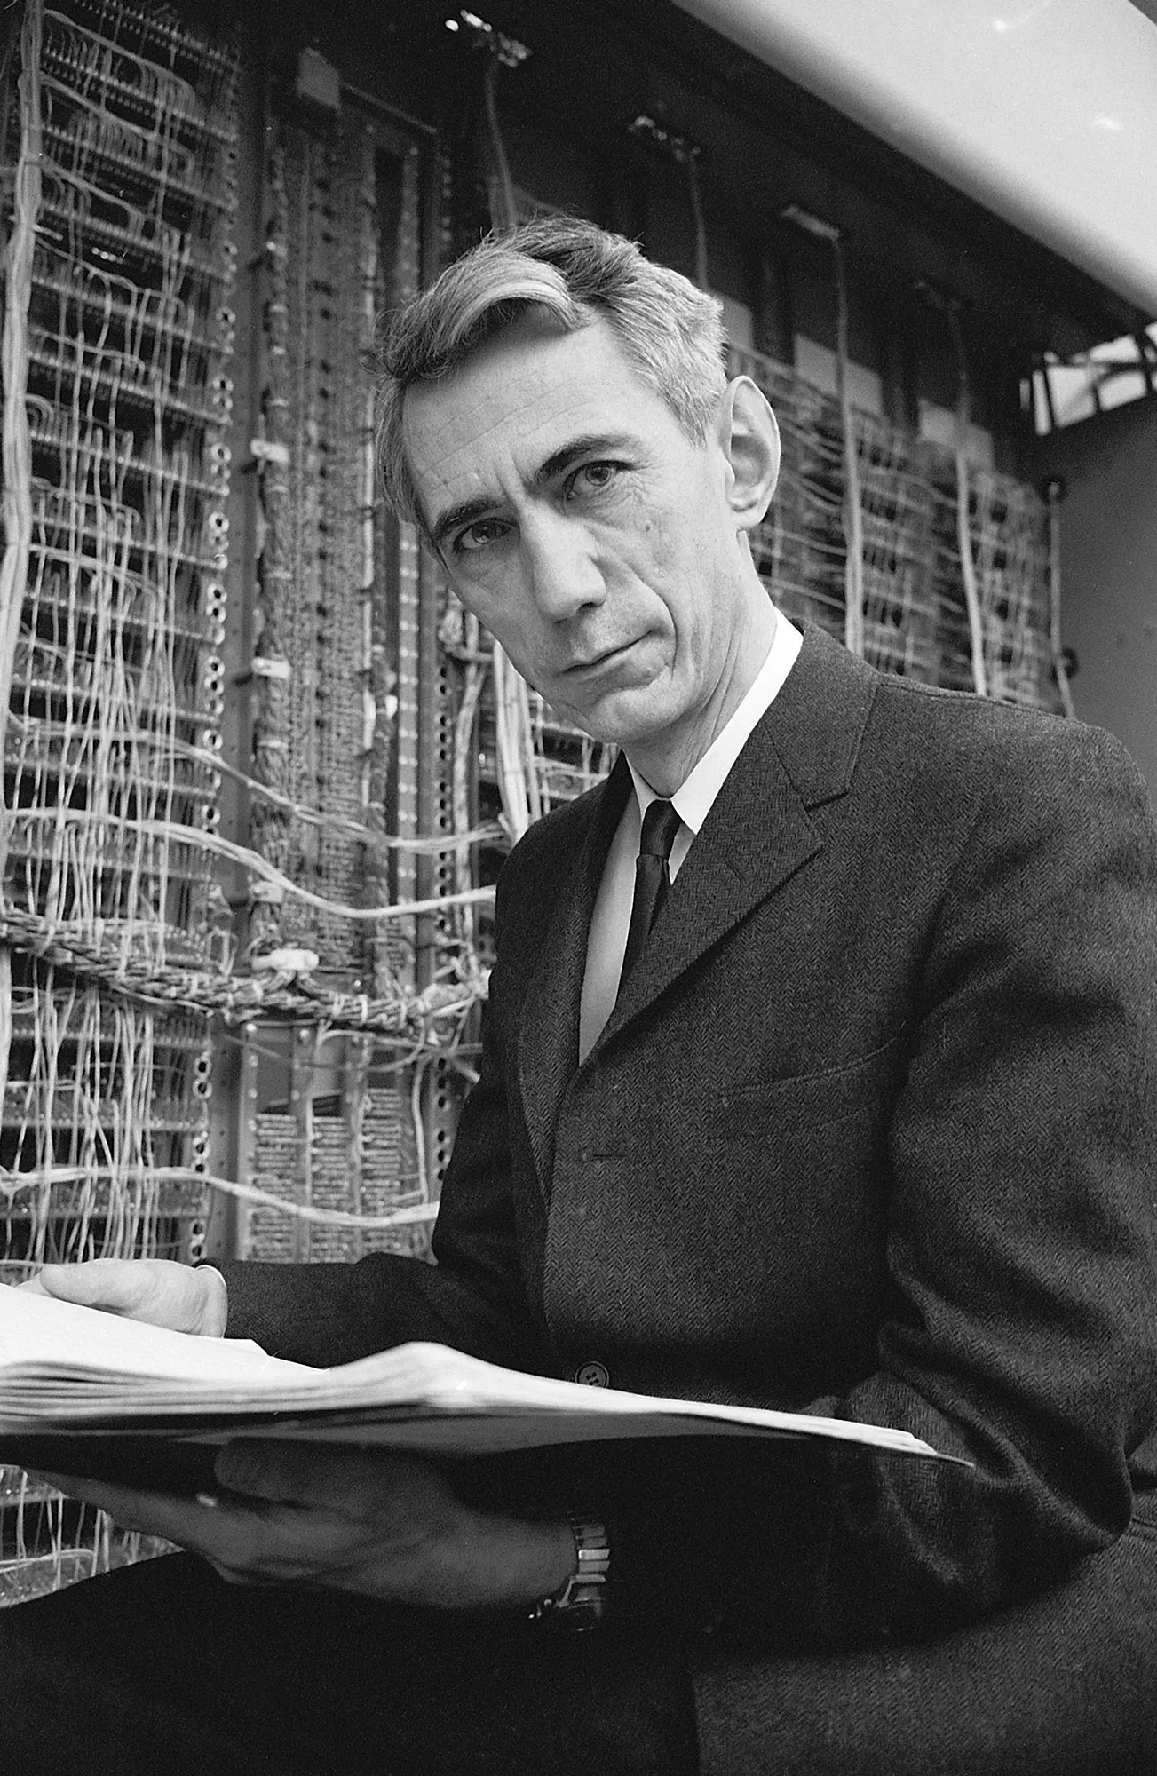
Tree Based Methods
Claude Shannon is known as the “father of information theory”.
Published “A Mathematical Theory of Communication” in 1948 in Bell System Technical Journal.

Slide 13
Tree Based Methods
Later published as “The Mathematical Theory of Communication”
Worked in many fields:
Circuit Design
Cryptography
Wearable Computers
Artificial Intelligence

Slide 14
Tree Based Methods
The ability to measure and define information will become more important as we learn the mathematics of how tree based methods are constructed.
We will revisit this idea later on, for now, let’s move on to the development of decision trees.

Slide 15
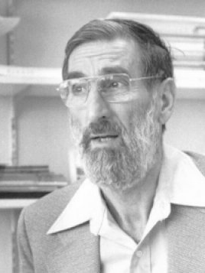
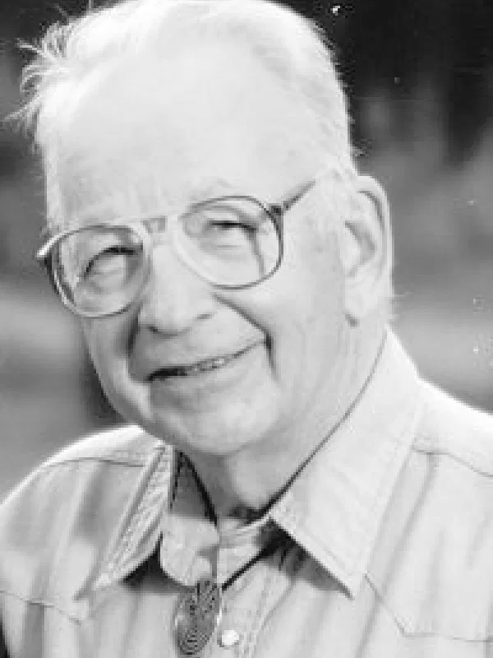
Tree Based Methods
1963: First publication of regression tree algorithm by Morgan and Sonquist

Slide 16
Tree Based Methods
1963: Morgan and Sonquist created piecewise-constant model with splits.

Slide 17
Tree Based Methods
1963: Piecewise-constant regression tree
Y
X

Slide 18
Tree Based Methods
1963: Piecewise-constant regression tree
3
Y
2
1
0
1
2
3
X

Slide 19
Tree Based Methods
1963: Piecewise-constant regression tree
3
Y
2
1
0
1
2
3
X

Slide 20
Tree Based Methods
1963: Piecewise-constant regression tree
3
Y
2
1
0
1
2
3
X

Slide 21
Tree Based Methods
1963: Piecewise-constant regression tree
X < 1
3
Y
2
1
0
1
2
3
X

Slide 22
Tree Based Methods
1963: Piecewise-constant regression tree
X ≤ 1
3
T
F
Y
2
Y=1.5
X ≤ 2
1
0
1
2
3
X

Slide 23
Tree Based Methods
1963: Piecewise-constant regression tree
X ≤ 1
3
T
F
Y
2
Y=1.5
X ≤ 2
1
T
F
Y=2.2
Y=1.5
0
1
2
3
X

Slide 24
Tree Based Methods
1963: Piecewise-constant regression tree
X ≤ 1
3
T
F
Y
2
Y=1.5
X ≤ 2
1
T
F
Y=2.2
Y=1.5
0
1
2
3
X

Slide 25
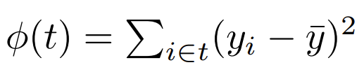
Tree Based Methods
In the 1963 paper, splits at each node t were decided based on node impurity, which was simply defined as an error metric:

Slide 26
Tree Based Methods
1972: Robert Messenger and Lewis Mandell publish first classification tree algorithm with “A model search technique for predictive nominal scale multivariate analysis.”
Split condition was named Theta Automatic Interaction Detection (THAID)

Slide 27
Tree Based Methods
1980: Gordon Kass publishes CHAID decision tree technique.
Based on further work built on top of THAID algorithm from 1970s.
CHAID: Chi-square automatic interaction detection .

Slide 28
Tree Based Methods
1970s: Leo Breiman and Charles Stone from Berkeley and Jerome Friedman and Richard Olshen from Stanford started developing the Classification and Regression tree (CART) based algorithms.

Slide 29
Tree Based Methods
1984: The CART book (Breiman et al.) is officially published, including a software implementation.
CART was a huge leap forward in the practical usage of decision tree algorithm.
CART based methods quickly became a standard (including scikit-learn!)

Slide 30
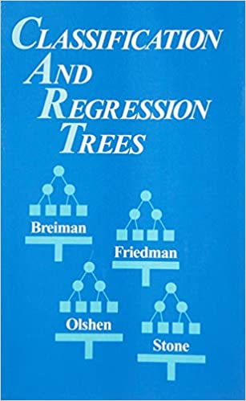
Tree Based Methods
CART introduces many concepts:
Cross validation of Trees
Pruning Trees
Surrogate Splits
Variable Importance Scores
Search for Linear Splits

Slide 31
Tree Based Methods
1986: John Ross Quinlan developed ID3 decision tree algorithm based on the “gain ratio”.
1990s: Improved on ID3 with C4.5 (still very popular).
2000s: Released highly optimized commercial version C5.0 with various improvements.

Slide 32
Tree Based Methods
Many of these improvements of basic decision trees were incorporated to other tree based methods such as random forests and gradient boosted trees.
Let’s move on to understanding the fundamental ideas behind a decision tree!

Slide 33
Decision Trees
Theory and Intuition: Decision Tree Basics

Slide 34
Decision Trees
To begin understanding a decision tree, we first need to review some terminology about the decision tree components.

Slide 35
Decision Trees
Recall our simple regression tree:
X ≤ 1
3
T
F
Y
2
Y=1.5
X ≤ 2
1
T
F
Y=2.2
Y=1.5
0
1
2
3
X

Slide 36
Decision Trees
Recall our simple regression tree:
X ≤ 1
T
F
Y=1.5
X ≤ 2
T
F
Y=2.2
Y=1.5

Slide 37
Decision Trees
Splitting
X ≤ 1
T
F
Y=1.5
X ≤ 2
T
F
Y=2.2
Y=1.5

Slide 38
Decision Trees
Splitting
X ≤ 1
T
F
Y=1.5
X ≤ 2
T
F
Y=2.2
Y=1.5

Slide 39
Decision Trees
Nodes:
X ≤ 1
T
F
Y=1.5
X ≤ 2
T
F
Y=2.2
Y=1.5

Slide 40
Decision Trees
Nodes:
X ≤ 1
T
F
Y=1.5
X ≤ 2
T
F
Y=2.2
Y=1.5

Slide 41
Decision Trees
Root Node:
X ≤ 1
T
F
Y=1.5
X ≤ 2
T
F
Y=2.2
Y=1.5

Slide 42
Decision Trees
Leaf (Terminal) Nodes:
X ≤ 1
T
F
Y=1.5
X ≤ 2
T
F
Y=2.2
Y=1.5

Slide 43
Decision Trees
Parent and Children Nodes:
X ≤ 1
T
F
Y=1.5
X ≤ 2
T
F
Y=2.2
Y=1.5

Slide 44
Decision Trees
Parent and Children Nodes:
X ≤ 1
T
F
Y=1.5
X ≤ 2
T
F
Y=2.2
Y=1.5

Slide 45
Decision Trees
Parent and Children Nodes:
X ≤ 1
T
F
Y=1.5
X ≤ 2
T
F
Y=2.2
Y=1.5

Slide 46
Decision Trees
Tree Branches (Sub Trees):
X ≤ 1
T
F
Y=1.5
X ≤ 2
T
F
Y=2.2
Y=1.5

Slide 47
Decision Trees
Tree Branches (Sub Trees):
X ≤ 1
T
F
Y=1.5
X ≤ 2
T
F
Y=2.2
Y=1.5

Slide 48
Decision Trees
Pruning:
X ≤ 1
T
F
Y=1.5
X ≤ 2
T
F
Y=2.2
Y=1.5

Slide 49

Decision Trees
Pruning:
X ≤ 1
T
F
Y=1.5
X ≤ 2
T
F
Y=2.2
Y=1.5

Slide 50
Decision Trees
Pruning:
X ≤ 1
T
F
Y=1.5
Y=1.9

Slide 51
Decision Trees
Let’s now move on to constructing a tree!
X ≤ 1
T
F
Y=1.5
X ≤ 2
T
F
Y=2.2
Y=1.5

Slide 52
Decision Trees
Theory and Intuition: Gini Impurity

Slide 53
Gini Impurity
Before we explore how splitting criterion is used in constructing decision trees, let’s explore the most common information measurement for decision trees, gini impurity.

Slide 54
Gini Impurity
Gini impurity is a mathematical measurement of how “pure” the information in a data set is.
In regards to classification, we can think of this as a measurement of class uniformity.
Let’s see how this relates to the simplest case of two classes...

Slide 55
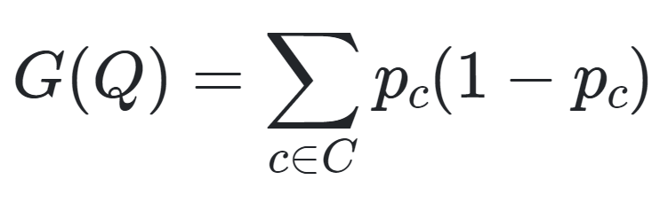
Gini Impurity
Gini Impurity for Classification:
For a set of classes C for a given dataset Q:

Slide 56
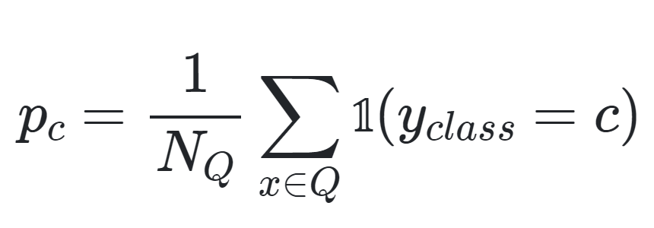
Gini Impurity
Gini Impurity for Classification:
For a set of classes C for a given dataset Q, p_{c} is probability of class c.

Slide 57
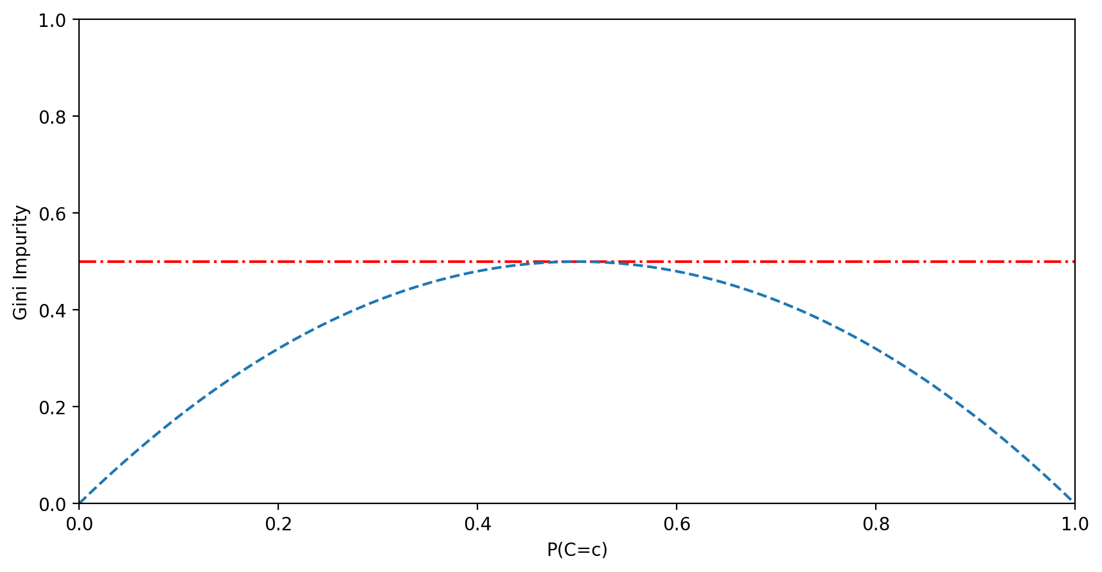
Gini Impurity
Gini Impurity for Classification:

Slide 58
Gini Impurity
Gini Impurity for Classification:

Slide 59
Gini Impurity
Gini Impurity for Classification:

Slide 60
Gini Impurity
Gini Impurity for Classification:
Class Red (2/4)(1 - 2/4) = 0.25

Slide 61
Gini Impurity
Gini Impurity for Classification:
Class Red (½)(1-½) = 0.5
Class Red (2/4)(1 - 2/4) = 0.25
Class Blue (2/4)(1 - 2/4) = 0.25

Slide 62
Gini Impurity
Gini Impurity for Classification:
Class Red (½)(1-½) = 0.5
Class Red (2/4)(1 - 2/4) = 0.25
Class Blue (2/4)(1 - 2/4) = 0.25
Gini Impurity 0.25 + 0.25 = 0.5

Slide 63
Gini Impurity
“Maximum” Impurity Possible
Class Red (½)(1-½) = 0.5
Class Red (2/4)(1 - 2/4) = 0.25
Class Blue (2/4)(1 - 2/4) = 0.25
Gini Impurity 0.25 + 0.25 = 0.5

Slide 64
Gini Impurity
Data is more “pure” (less impurity)
Class Red (½)(1-½) = 0.5
Class Red
(1/4)(1 - 1/4) = 0.1875
Class Blue (3/4)(1 - 3/4) =0.1875
Gini Impurity 0.1875+0.1875 = 0.375

Slide 65
Gini Impurity
Data is completely “pure” (no impurity)
Class Red (½)(1-½) = 0.5
Class Red
(0/4)(1 - 0/4) = 0
Class Blue (4/4)(1 - 4/4) = 0
Gini Impurity
0 + 0 = 0

Slide 66
Gini Impurity
If the goal of a decision tree is to separate out classes, we can use gini impurity to decide on data split values.
We want to minimize the gini impurity at leaf nodes.
Minimized impurity at leaf nodes means we are separating classes effectively!

Slide 67
Gini Impurity
In the next lecture we will construct a basic example of using gini impurity from a data set to calculate feature gini impurity.
Afterwards, we’ll explore splitting various feature types and deciding which feature should be the root node.

Slide 68
Decision Trees
Theory and Intuition: Gini Impurity in Trees

Slide 69
Decision Trees
Let’s begin to understand how the ordering of nodes is decided and how splits are conducted within a tree.
We’ll start by exploring how a decision tree is constructed from a training data set using gini impurity.

Slide 70
Decision Trees
When first constructing a tree, we need to decide what feature will be used as the root node.
We can use gini impurity to compare the information contained within features for the training data.
Let’s explore this concept further...

Slide 71
Decision Trees
Gini Impurity for Classification:
For a set of classes C for a given dataset Q:

Slide 72
Decision Trees
Gini Impurity for Classification:
For a set of classes C for a given dataset Q, p_{c} is probability of class c.

Slide 73
Decision Trees
Gini Impurity for Classification:
For a set of classes C for a given dataset Q, p_{c} is probability of class c.

Slide 74
Decision Trees
Let’s take a look at this data set:
X - URL Link | Y-Spam
Yes | Yes
Yes | Yes
No | No
No | No
No | Yes
No | No
Yes | No

Slide 75
Decision Trees
Create a decision tree to predict spam.
X - URL Link | Y-Spam
Yes | Yes
Yes | Yes
No | No
No | No
No | Yes
No | No
Yes | No

Slide 76
Decision Trees
Only one X feature to use for a node.
X - URL Link | Y-Spam
Yes | Yes
Yes | Yes
No | No
No | No
No | Yes
No | No
Yes | No
URL

Slide 77
Decision Trees
Predict if email is spam if it contains a URL:
X - URL Link | Y-Spam
Yes | Yes
Yes | Yes
No | No
No | No
No | Yes
No | No
Yes | No
URL
T
F

Slide 78
Decision Trees
Predict if email is spam if it contains a URL:
X - URL Link | Y-Spam
Yes | Yes
Yes | Yes
No | No
No | No
No | Yes
No | No
Yes | No
URL
T
Spam
Yes: 2
No: 1

Slide 79
Decision Trees
Predict if email is spam if it contains a URL:
X - URL Link | Y-Spam
Yes | Yes
Yes | Yes
No | No
No | No
No | Yes
No | No
Yes | No
URL
T
F
Spam
Yes: 2
No: 1
Spam
Yes: 1
No: 3

Slide 80
Decision Trees
Predict if email is spam if it contains a URL:
X - URL Link | Y-Spam
Yes | Yes
Yes | Yes
No | No
No | No
No | Yes
No | No
Yes | No
URL
T
F
Spam
Yes: 2
No: 1
Spam
Yes: 1
No: 3

Slide 81
Decision Trees
Recall the gini impurity formula:
X - URL Link | Y-Spam
Yes | Yes
Yes | Yes
No | No
No | No
No | Yes
No | No
Yes | No
URL
T
F
Spam
Yes: 2
No: 1
Spam
Yes: 1
No: 3

Slide 82
Decision Trees
Treat Yes Spam and No Spam as C classes:
URL
T
F
Spam
Yes: 2
No: 1
Spam
Yes: 1
No: 3

Slide 83
Decision Trees
Treat Yes Spam and No Spam as c classes:
Left Leaf Node:
(⅔)(1-⅔)
URL
T
F
Spam
Yes: 2
No: 1
Spam
Yes: 1
No: 3

Slide 84
Decision Trees
Treat Yes Spam and No Spam as c classes:
Left Leaf Node:
(⅔)(1-⅔) + (⅓)(1-⅓)
URL
T
F
Spam
Yes: 2
No: 1
Spam
Yes: 1
No: 3

Slide 85
Decision Trees
Treat Yes Spam and No Spam as c classes:
Left Leaf Node:
(⅔)(1-⅔) + (⅓)(1-⅓)
Left Leaf Gini=0.44
URL
T
F
Spam
Yes: 2
No: 1
Spam
Yes: 1
No: 3

Slide 86
Decision Trees
Treat Yes Spam and No Spam as c classes:
Left Leaf Node:
(⅔)(1-⅔) + (⅓)(1-⅓)
Left Leaf Gini=0.44
Right Leaf Node:
(¼)(1-¼) + (¾)(1-¾)
Right Leaf Gini=0.375
URL
T
F
Spam
Yes: 2
No: 1
Spam
Yes: 1
No: 3

Slide 87
Decision Trees
Now calculate gini impurity of URL feature.
Weighted Average of both:
Left Leaf Gini=0.44
Right Leaf Gini=0.375
URL
T
F
Spam
Yes: 2
No: 1
Spam
Yes: 1
No: 3

Slide 88
Decision Trees
Total Emails: (2+1) + (1+3) = 7
Left Leaf Gini=0.44
Right Leaf Gini=0.375
URL
T
F
Spam
Yes: 2
No: 1
Spam
Yes: 1
No: 3

Slide 89
Decision Trees
Total Emails: (2+1) + (1+3) = 7
Left Leaf Gini=0.44
Right Leaf Gini=0.375
Left Emails: 3
Right Emails: 4
URL
T
F
Spam
Yes: 2
No: 1
Spam
Yes: 1
No: 3

Slide 90
Decision Trees
Total Emails: (2+1) + (1+3) = 7
Left Leaf Gini=0.44
Right Leaf Gini=0.375
Left Emails: 3
Right Emails: 4
(3/7)*0.44 + (4/7)*0.375
URL
T
F
Spam
Yes: 2
No: 1
Spam
Yes: 1
No: 3

Slide 91
Decision Trees
Total Emails: (2+1) + (1+3) = 7
Left Leaf Gini=0.44
Right Leaf Gini=0.375
Left Emails: 3
Right Emails: 4
(3/7)*0.44 + (4/7)*0.375
Gini Impurity: 0.403
URL
T
F
Spam
Yes: 2
No: 1
Spam
Yes: 1
No: 3

Slide 92
Decision Trees
Gini Impurity for URL feature: 0.403
URL
T
F
Spam
Yes: 2
No: 1
Spam
Yes: 1
No: 3

Slide 93
Decision Trees
But what if we had multiple features?
URL
T
F
Spam
Yes: 2
No: 1
Spam
Yes: 1
No: 3

Slide 94
Decision Trees
We still have more issues to consider:
Multiple Features
Continuous Features
Multi-categorical Features
We can incorporate the gini impurity to each of these issues to solve for best root nodes and best split parameters for leaves.

Slide 95
Decision Trees
Theory and Intuition: Gini Impurity Part Two

Slide 96
Decision Trees
We explored how to calculate gini impurity for a binary categorical feature (only consisting of two categories).
Now let’s explore the following:
Continuous numeric features
Multi-categorical features (N>2)
Choosing a root node feature

Slide 97
Decision Trees
Imagine a continuous feature:
X - Words in Email | Y-Spam
10 | Yes
40 | No
20 | Yes
50 | No
30 | No

Slide 98
Decision Trees
Let’s calculate the feature gini impurity:
X - Words in Email | Y-Spam
10 | Yes
40 | No
20 | Yes
50 | No
30 | No

Slide 99
Decision Trees
First sort data:
X - Words in Email | Y-Spam
10 | Yes
40 | No
20 | Yes
50 | No
30 | No

Slide 100
Decision Trees
First sort data:
X - Words in Email | Y-Spam
10 | Yes
20 | Yes
30 | No
40 | No
50 | No

Slide 101
Decision Trees
Calculate potential split values for node:
X - Words in Email | Y-Spam
10 | Yes
20 | Yes
30 | No
40 | No
50 | No

Slide 102
Decision Trees
Calculate potential split values for node:
Words ≤ N
X - Words in Email | Y-Spam
10 | Yes
20 | Yes
30 | No
40 | No
50 | No

Slide 103
Decision Trees
Use averages between rows as values:
Words ≤ N
X - Words in Email | Y-Spam
10 | Yes
20 | Yes
30 | No
40 | No
50 | No
15
25
35
45

Slide 104
Decision Trees
Perform each potential split:
Words ≤ 15
X - Words in Email | Y-Spam
10 | Yes
20 | Yes
30 | No
40 | No
50 | No
15
25
35
45

Slide 105
Decision Trees
Calculate gini impurity for each split:
Words ≤ 15
X - Words in Email | Y-Spam
10 | Yes
20 | Yes
30 | No
40 | No
50 | No
15

Slide 106
Decision Trees
Calculate gini impurity for each split:
Words ≤ 15
X - Words in Email | Y-Spam
10 | Yes
20 | Yes
30 | No
40 | No
50 | No
15

Slide 107
Decision Trees
Calculate gini impurity for each split:
Words ≤ 15
X - Words in Email | Y-Spam
10 | Yes
20 | Yes
30 | No
40 | No
50 | No
15
Spam:
Yes: 1
No: 0
Spam:
Yes: 1
No: 3

Slide 108
Decision Trees
Calculate gini impurity for each split:
Words ≤ 15
X - Words in Email | Y-Spam
10 | Yes
20 | Yes
30 | No
40 | No
50 | No
15
Spam:
Yes: 1
No: 0
Spam:
Yes: 1
No: 3
(⅕)(0+0) + (⅘)((¼)(1-¼)+(¾)(1-¾)

Slide 109
Decision Trees
Calculate gini impurity for each split:
Words ≤ 15
X - Words in Email | Y-Spam
10 | Yes
20 | Yes
30 | No
40 | No
50 | No
15
Spam:
Yes: 1
No: 0
Spam:
Yes: 1
No: 3
(⅕)(0+0) + (⅘)((¼)(1-¼)+(¾)(1-¾)
0.3

Slide 110
Decision Trees
Calculate gini impurity for each split:
X - Words in Email | Y-Spam
10 | Yes
20 | Yes
30 | No
40 | No
50 | No
15
Gini=0.3

Slide 111
Decision Trees
Repeat for all possible splits:
X - Words in Email | Y-Spam
10 | Yes
20 | Yes
30 | No
40 | No
50 | No
15
Gini=0.3
Gini=0
25
35
Gini=0.26
45
Gini=0.4

Slide 112
Decision Trees
Choose lowest impurity split value
X - Words in Email | Y-Spam
10 | Yes
20 | Yes
30 | No
40 | No
50 | No
Gini=0
25

Slide 113
Decision Trees
Choose this as split value for node.
Words ≤ 25
X - Words in Email | Y-Spam
10 | Yes
20 | Yes
30 | No
40 | No
50 | No
25
Spam:
Yes: 2
No: 0
Spam:
Yes: 0
No: 3
0

Slide 114
Decision Trees
We have now calculated gini impurity for features that are:
Binary categories
Continuous numeric
Finally, let’s explore calculating gini impurity for a feature that is multicategorical.

Slide 115
Decision Trees
Multicategorical feature:
X - Sender | Y-Spam
Abe | Yes
Bob | Yes
Claire | No
Abe | No
Bob | No

Slide 116
Decision Trees
Calculate gini impurity for all combinations:
X - Sender | Y-Spam
Abe | Yes
Bob | Yes
Claire | No
Abe | No
Bob | No

Slide 117
Decision Trees
Calculate gini impurity for all combinations:
Sender == Abe
X - Sender | Y-Spam
Abe | Yes
Bob | Yes
Claire | No
Abe | No
Bob | No
Spam:
Yes: 1
No: 1
Spam:
Yes: 1
No: 2

Slide 118
Decision Trees
Calculate gini impurity for all combinations:
Sender == Abe
X - Sender | Y-Spam
Abe | Yes
Bob | Yes
Claire | No
Abe | No
Bob | No

Slide 119
Decision Trees
Calculate gini impurity for all combinations:
Sender == Abe
X - Sender | Y-Spam
Abe | Yes
Bob | Yes
Claire | No
Abe | No
Bob | No
Sender == Bob
Sender == Claire

Slide 120
Decision Trees
Calculate gini impurity for all combinations:
Sender == Abe
Sender ==
Abe or Bob
X - Sender | Y-Spam
Abe | Yes
Bob | Yes
Claire | No
Abe | No
Bob | No
Sender == Bob
Sender ==
Claire or Bob
Sender == Claire
Sender ==
Abe or Claire

Slide 121
Decision Trees
Choose lowest impurity split combination.
Sender == Abe
Sender ==
Abe or Bob
X - Sender | Y-Spam
Abe | Yes
Bob | Yes
Claire | No
Abe | No
Bob | No
Sender == Bob
Sender ==
Claire or Bob
Sender == Claire
Sender ==
Abe or Claire

Slide 122
Decision Trees
Now we can split any type of feature.
How does the decision tree decide on the root node of a multi-feature dataset?
Calculate the gini impurity values of each feature and choose the lowest impurity value to split on first.

Slide 123
Decision Trees
By choosing the feature with the lowest resulting gini impurity in its leaf nodes, we are choosing the feature that best splits the data into “pure” classes.

Slide 124
Decision Trees
We should also note, by using gini impurity as a measurement of the effectiveness of a node split, we can perform automatic feature selection by mandating an impurity threshold for an additional feature based split to occur.

Slide 125
Decision Trees
A large overfitted tree:

Slide 126
Decision Trees
Add minimum gini impurity decrease

Slide 127
Decision Trees
Add minimum gini impurity decrease

Slide 128
Decision Trees
Add minimum gini impurity decrease

Slide 129
Decision Trees
We can also mandate a max depth:

Slide 130
Decision Trees
We can also mandate a max depth:

Slide 131
Decision Trees
We can also mandate a max depth:

Slide 132
Decision Trees
Let’s begin to explore these various hyperparameters with code!

Slide 133
Decision Trees
Coding Part One: The Data

Slide 134
Decision Trees
Coding Part Two: Creating the Model

